Slide 1
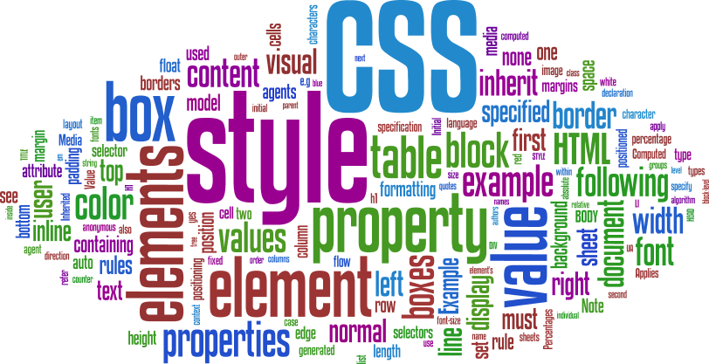

CSS Presentation
http://html5course.telerik.com
How to make things shiny?

Slide 2

Table of Contents
Text-related Properties
Borders
Backgrounds
Background color
Background image
Gradient Background
Opacity

Slide 3

Text-related Properties

Slide 4
Text-related CSS Properties
color – specifies the color of the text
font-size – size of font: xx-small, x-small, small, medium, large, x-large, xx-large, smaller, larger or numeric value
font-family – comma separated font names
Example: verdana, sans-serif, etc.
The browser loads the first one that is available
There should always be at least one generic font
font-weight can be normal, bold, bolder, lighter or a number in range [100 … 900]

Slide 5
CSS Rules for Fonts (2)
font-style – styles the font
Values: normal, italic, oblique
text-decoration – decorates the text
Values: none, underline, line-trough, overline, blink
text-align – defines the alignment of text or other content
Values: left, right, center, justify

Slide 6
Shorthand Font Property
font
Shorthand rule for setting multiple font properties at the same time
is equal to writing this:
font:italic normal bold 12px/16px verdana
font-style: italic;
font-variant: normal;
font-weight: bold;
font-size: 12px;
line-height: 16px;
font-family: verdana;

Slide 7
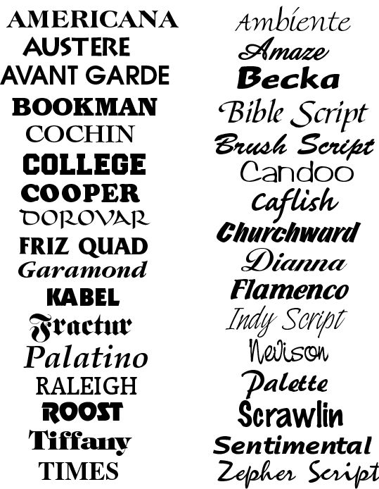




Text-related Properties
Live Demo

Slide 8




More Fonts

Slide 9

Font Embeds
Use @font-face to declare font
Point to font file on server
Call font with font-family
Currently not supported in IE
Use font embedding instead of images
@font-face {
font-family: SketchRockwell;
src: url('SketchRockwell-Bold.ttf');
}
.my_CSS3_class {
font-family: SketchRockwell;
font-size: 3.2em;
}

Slide 10


Text Shadow
Applies shadow to text
Syntax: text-shadow: <horizontal-distance> <vertical-distance> <blur-radius> <shadow-color>;
Do not alter the size of a box
text-shadow: 2px 2px 7px #000000;

Slide 11


Text Overflow
Specifies what should happen when text overflows the containing element
Syntax: text-overflow: <value>;
Possible values:
ellipsis - Display ellipses to represent clipped text
clip - Default value, clips text
Currently not supported in Firefox and IE

Slide 12
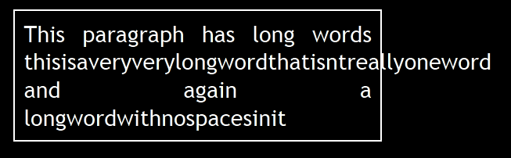
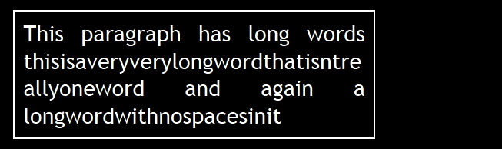
Word Wrapping
Allows long words to be able to be broken and wrap onto the next line
Syntax: word-wrap: <value>;
Possible values:
normal
break-word
Supported in all major browsers

Slide 13
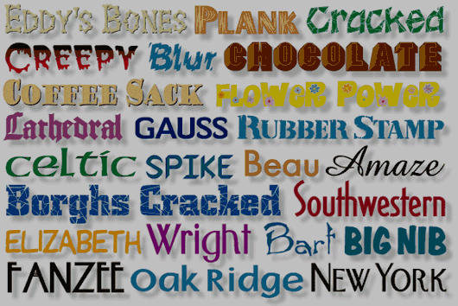
More Fonts
Live Demo

Slide 14
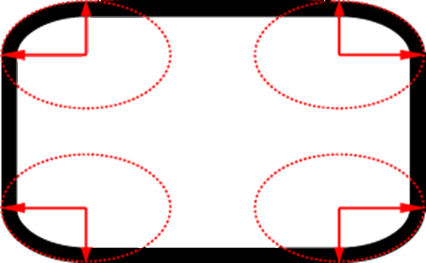
Borders

Slide 15
Borders
border-width: thin, medium, thick or numerical value (e.g. 10px)
border-color: color alias or RGB value
border-style: none, hidden, dotted, dashed, solid, double, groove, ridge, inset, outset
Each property can be defined separately for left, top, bottom and right
border-top-style, border-left-color, …

Slide 16
Border Shorthand Property
border: shorthand rule for setting border properties at once:
is equal to writing:
Specify different borders for the sides via shorthand rules: border-top, border-left, border-right, border-bottom
border:none or border:0?
border: 1px solid red
border-width:1px;
border-color:red;
border-style:solid;

Slide 17
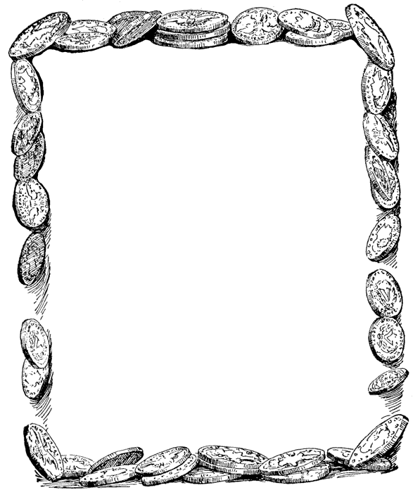
Borders
Live Demo

Slide 18
Border color
Allows you to create cool colored borders
Only Firefox supports this type of coloring
border: 8px solid #000; -moz-border-bottom-colors: #555 #666 #777 #888 #999 #aaa #bbb #ccc; -moz-border-top-colors: #555 #666 #777 #888 #999 #aaa #bbb #ccc; -moz-border-left-colors: #555 #666 #777 #888 #999 #aaa #bbb #ccc; -moz-border-right-colors: #555 #666 #777 #888 #999 #aaa #bbb #ccc;

Slide 19

Box shadow
Allows to easily implement multiple drop shadows (outer or inner) on box elements
Specifying values for color, size, blur and offset
Example:
-moz-box-shadow: 10px 10px 5px #888; -webkit-box-shadow: 10px 10px 5px #888; box-shadow: 10px 10px 5px #888;

Slide 20
Rounded Corners
Rounded corners are a part of CSS 3
Supported in all major browsers
Firefox, IE 9, Chrome, Opera and Safari
Done by the border-radius property
Three ways to define corner radius:
border-radius: [<length>|<%>][<length>|<%>]?
border-radius: 15px;
border-radius: 15px 15px 15px 10px;
border-radius: 15px 20px;

Slide 21

Other Border Styles
Live Demo

Slide 22

Background Properties

Slide 23
Backgrounds
background-image
URL of image to be used as background, e.g.:
background-color
Using color and image and the same time
background-repeat
repeat-x, repeat-y, repeat, no-repeat
background-attachment
fixed / scroll
background-image:url("back.gif");

Slide 24
Backgrounds (2)
background-position: specifies vertical and horizontal position of the background image
Vertical position: top, center, bottom
Horizontal position: left, center, right
Both can be specified in percentage or other numerical values
Examples:
background-position: top left;
background-position: -5px 50%;

Slide 25
Background Shorthand Property
background: shorthand rule for setting background properties at the same time:
is equal to writing:
Some browsers will not apply BOTH color and image for background if using shorthand rule
background: #FFF0C0 url("back.gif") no-repeat fixed top;
background-color: #FFF0C0;
background-image: url("back.gif");
background-repeat: no-repeat;
background-attachment: fixed;
background-position: top;

Slide 26
Background-image or <img>?
Background images allow you to save many image tags from the HTML
Leads to less code
More content-oriented approach
All images that are not part of the page content (and are used only for "beautification") should be moved to the CSS

Slide 27
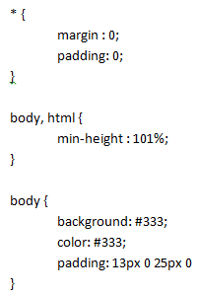

Background Styles
Live Demo

Slide 28

Gradient Backgrounds
Gradients are smooth transitions between two or more specified colors
Use of CSS gradients can replace images and reduce download time
Lots of gradient generators on the WEB
Create a more flexible layout, and look better while zooming
Supported in all major browsers via different keywords
This is still an experimental feature

Slide 29

Gradient Backgrounds Example
/* Firefox 3.6+ */
background: -moz-linear-gradient(100% 100% 90deg,
#FFFF00, #0000FF);
/* Safari 4-5, Chrome 1-9 */
background: -webkit-gradient(linear, 0% 0%, 0%
100%, from(#0000FF), to(#FFFF00));
/* Safari 5.1+, Chrome 10+ */
background: -webkit-linear-gradient(#FFFF00,
#0000FF);
/* Opera 11.10+ */
background: -o-linear-gradient(#2F2727, #0000FF);

Slide 30


Gradient Background
Live Demo

Slide 31



Multiple Backgrounds
CSS3 allows multiple background images
Simple comma-separated list of images
Supported in Firefox (3.6+), Chrome (1.0/1.3+), Opera (10.5+) and Internet Explorer (9.0+)
Comma separated list for the other properties
background-image: url(sheep.png), url(grass.png);

Slide 32

Multiple Backgrounds
Live Demo

Slide 33

Opacity

Slide 34
Opacity
opacity: specifies the opacity of the element
Floating point number from 0 to 1
For old Mozilla browsers use –moz-opacity
For IE use filter:alpha(opacity=value) where value is from 0 to 100; also, "binary and script behaviors" must be enabled and hasLayout must be triggered, e.g. with zoom:1

Slide 35
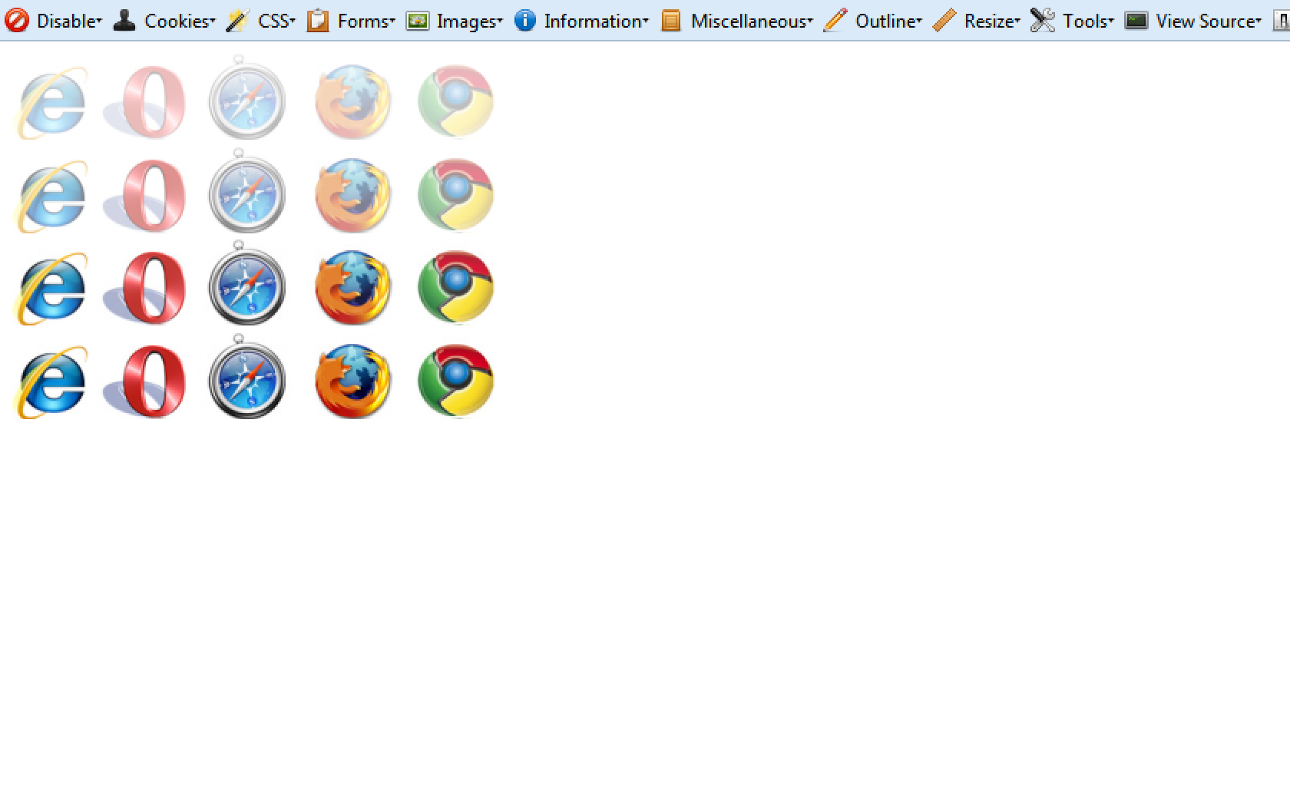
Opacity
Live Demo

Slide 36
CSS Presentation
http://academy.telerik.com

Slide 37
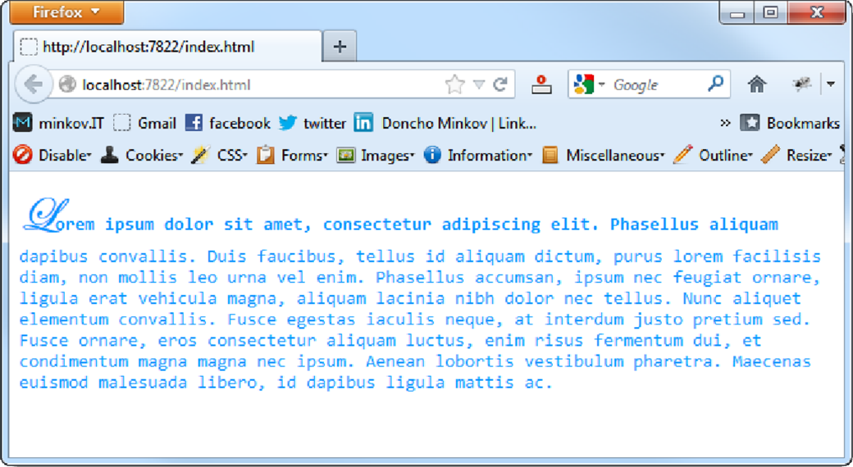
Homework
Create the following web page
Fonts used: Consolas, Edwardian Script ITC
Color: #0094ff

Slide 38
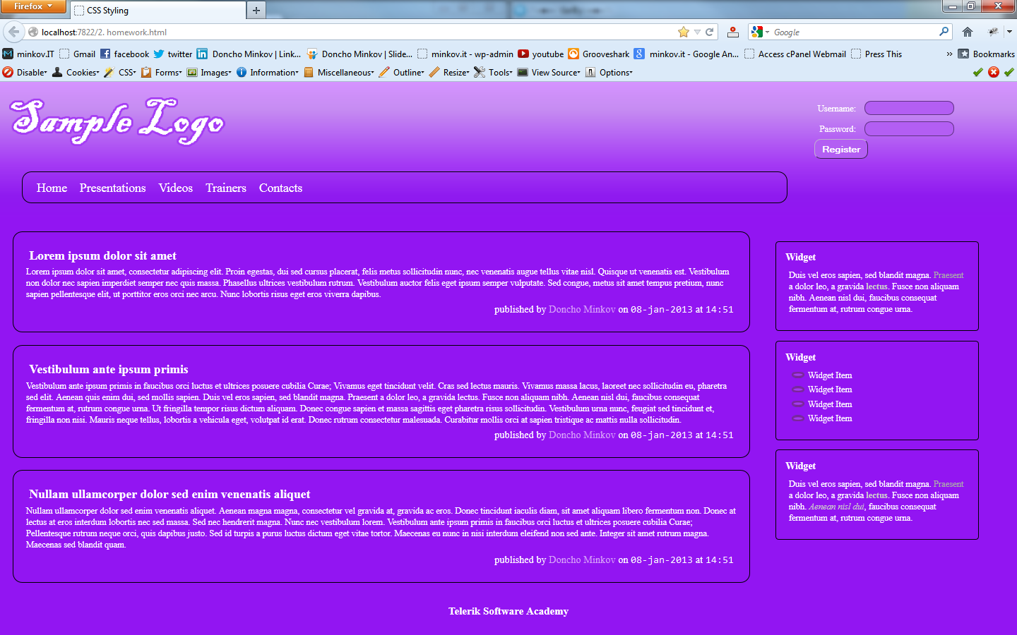
Homework (2)
You are given prewritten HTML and CSS code. Expand this code to make the web page to look exactly like the PNG image:
You can find the files in 2. Homework.zip

Slide 39
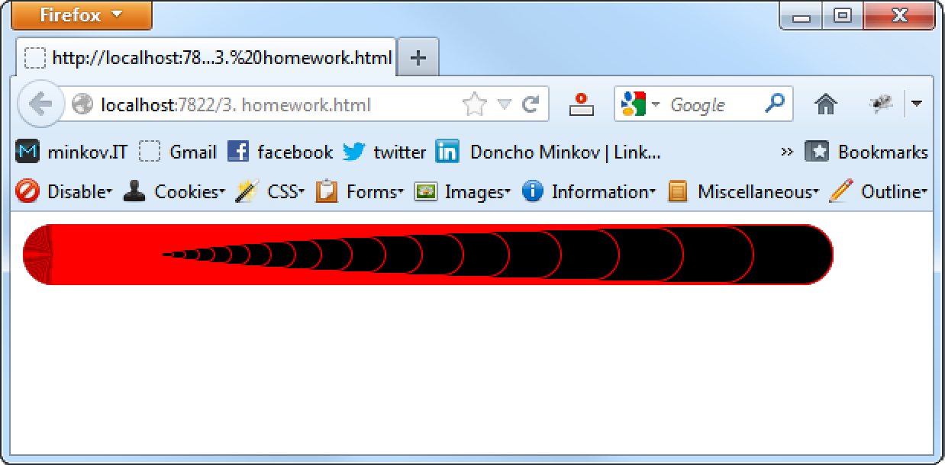
Homework (3)
Create the following web page
Using 60 nested div elements

Slide 40
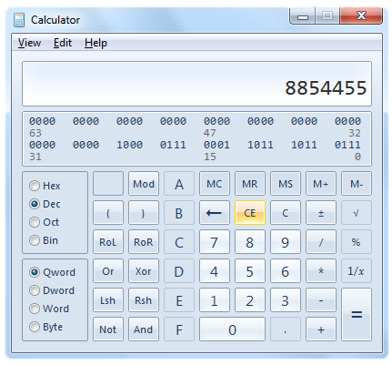
Homework (4)
Create a web page that looks like the Windows calculator in Programmer view
It should look exactly the same
Implement hover effects for the buttons
The calculator should not have any functionality

